Slide 1



Introduction to StarGate
Alexey Osipov
Senior Math Developer, Scrum Master

Slide 2


Who am I?
2007-2010 Math Developer (Betting company Marathon)
2010 Ph.D. in mathematics (dynamical systems)
2010-2014 Postdoc (SNS di Pisa, FU Berlin, Chebyshev Lab SPB)
2014-2018 Quant (Investment company OLMA)
2018 Senior Math Developer (Syncretis, NEXT)
2018-2019 Senior Math Developer (Syncretis, Actus)
2019-2021 Senior Math Developer, Scrum Master (Syncretis, LRD)

Slide 3

What is LRD?
LRD means Liability Risk Drivers
CRD means Casualty Research & Development
LED (Team Mango) means Loss and Exposure Database
LED is a data science project that is fully in StarGate

Slide 4

What is StarGate?
Stargate (swissre.com)
Platform for work with data, joined project by Swiss Re and Palantir.
Cluster with Spark (parallel computation)
many apps for various tasks
support service provided by Palantir
possibility to export data, which is not encouraged
data ingestion requires DGF
Python, R, SQL, Java, Mesa are supported

Slide 5
1
Stages
of work with data
Ingestion

Slide 6
1
Stages
of work with data
Ingestion
2
Analysis

Slide 7
1
Stages
of work with data
Ingestion
2
Analysis
3
Processing

Slide 8
1
Stages
of work with data
Ingestion
2
Analysis
3
4
Processing
Modelling

Slide 9
1
Stages
of work with data
Ingestion
2
Analysis
5
3
Visualization
4
Processing
Modelling

Slide 10
1
Stages
of work with data
6
Ingestion
2
Production
Analysis
5
3
Visualization
4
Processing
Modelling

Slide 11
1
Stages
of work with data
6
Ingestion
2
Production
7
Analysis
5
Troubleshooting
3
Visualization
4
Processing
Modelling

Slide 12
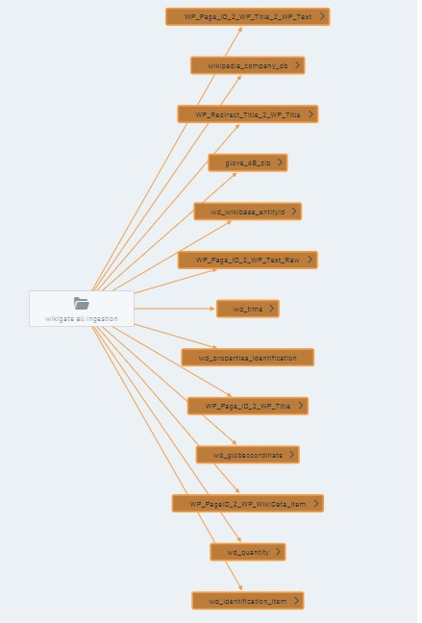
Data
ingestion with magrittr
Task:
we need to have up-to-date data from Wikipedia on loss events.
Citrix Receiver (swissre.com)
guw_data_source_wikidata_repo (swissre.com)

Slide 13
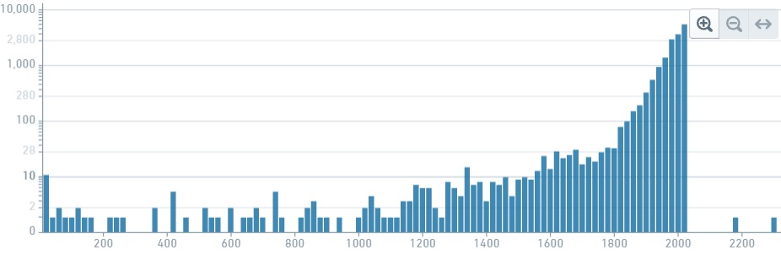
Data analysis with contour
What can we say about this dataset?
wd_events (swissre.com)

Slide 14

Data processing with code repos
How to call geo api from StarGate?
geoapi (swissre.com)
guw_pipeline_wikigate_repo (swissre.com)

Slide 15
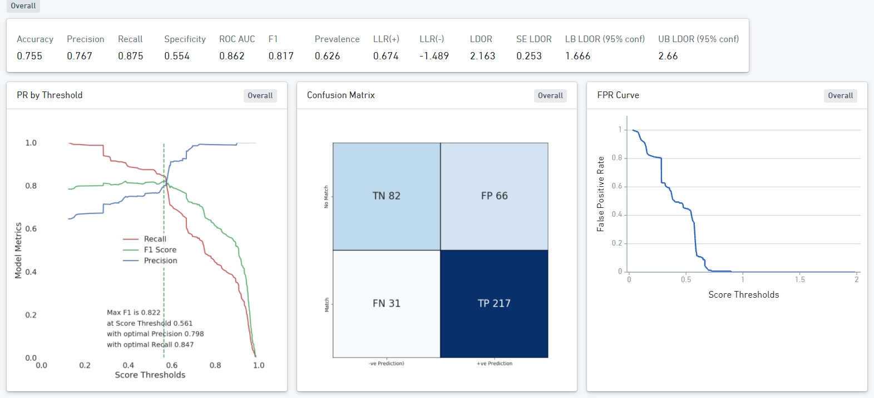
Data modelling with code workbooks
How to check if a company name is present in a claim name?
DistinguishCompaniesFromNoise (swissre.com)

Slide 16
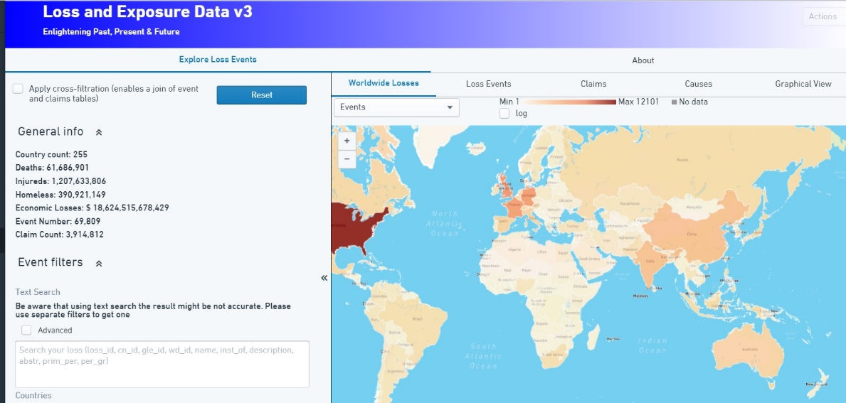
Data visualization with slate
How to make a web app in StarGate?
SQL, Javascript, html, css
Loss_and_Exposure_Data_v3 (swissre.com)

Slide 17
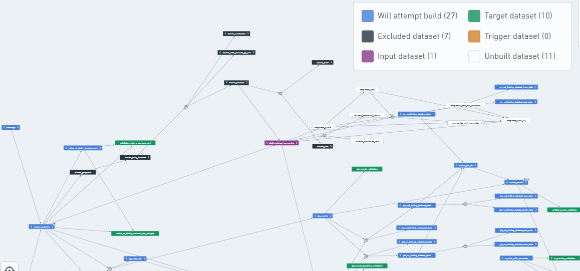
Production with lineage graphs
guw_pipeline_wikigate_repo
(swissre.com)
How to run the pipeline via scheduler?

Slide 18

Troubleshooting with issues
How to solve a problem that you do now know how to solve?
My issues: Issues • All (17) (swissre.com)

Slide 19

Conclusions
StarGate is future of most of Swiss Re projects
dealing with data.
Pros:
Many apps for various cases.
Fast computation.
Support of various languages.
Courses by Palantir.
Cons:
Hard to get data in, hard to get data out.
Palantir support.

Slide 20

Thank you very much!
And feel free to ask questions!

